Slide 1
A* Path Planning Library

Slide 2
Graph Generation Tools

Slide 3
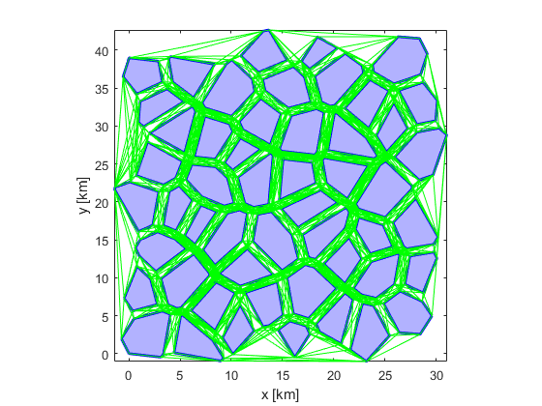
The A* toolbox can handle generation of both simple and complex visibility graphs

Slide 4
Visibility graph modification tools allow easy removal or addition of obstacles from a map

Slide 5
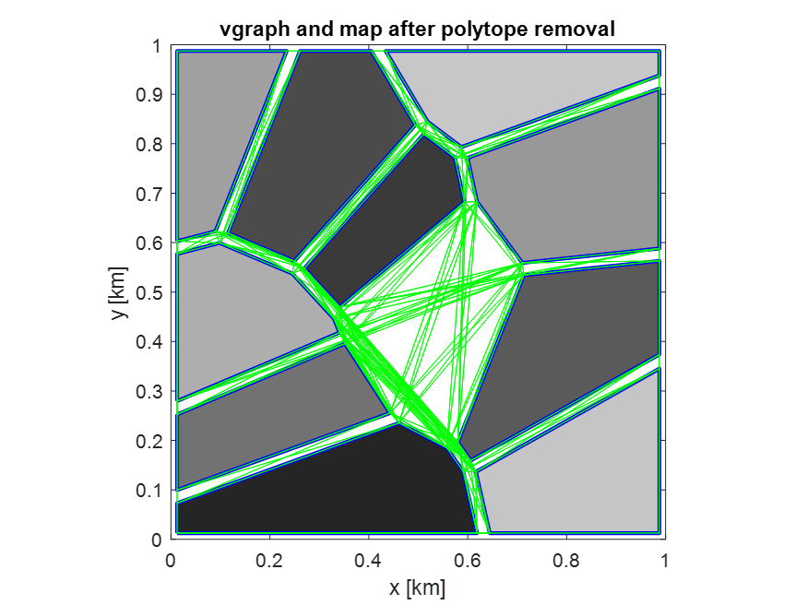
Visibility graph modification tools allow easy removal or addition of obstacles from a map

Slide 6
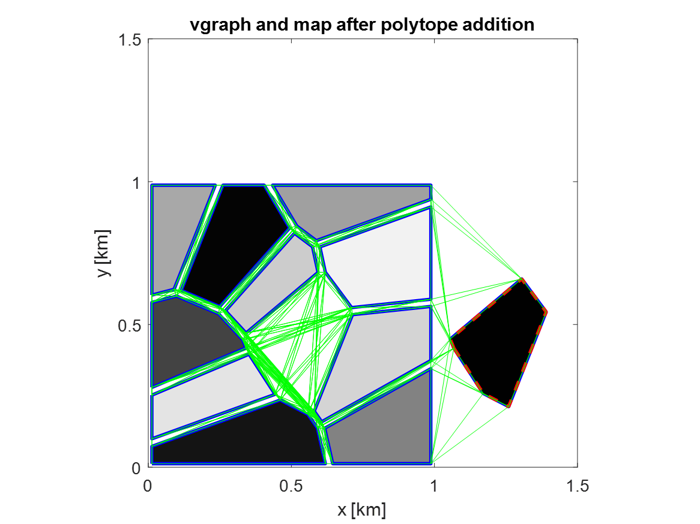
Visibility graph modification tools allow easy removal or addition of obstacles from a map

Slide 7
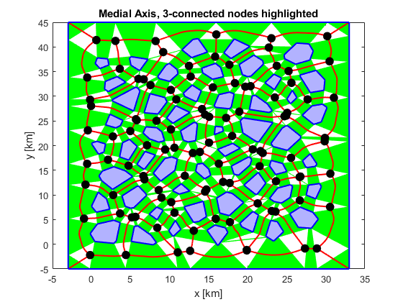
The medial axis graph is created by triangulating the free space to find the path in the middle of two obstacles

Slide 8
Medial axis graphs have significantly fewer nodes than visibility graphs, making them good for use in denser obstacle fields

Slide 9
Path Planning Tools

Slide 10
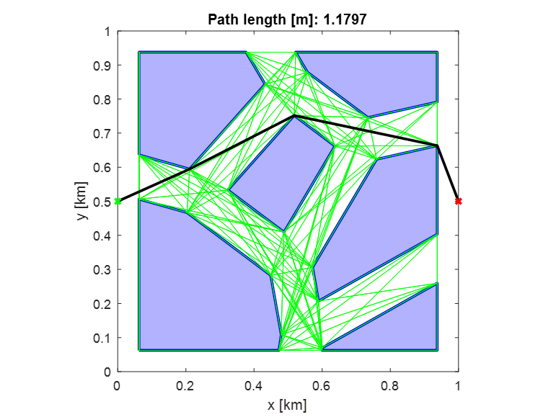
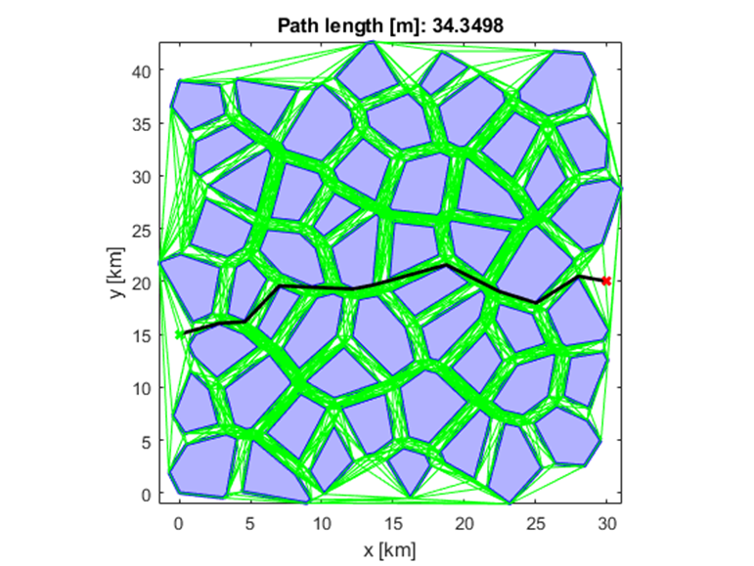
A* path planning on generated visibility graphs

Slide 11
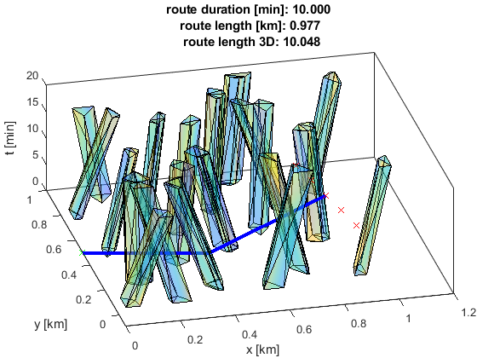
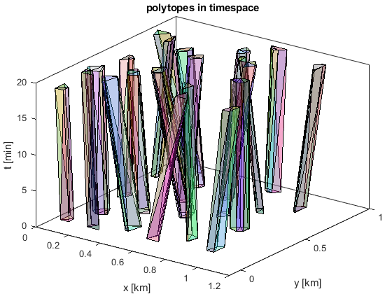
The 3d version of the A* planner can work in timespace to intercept a goal on a trajectory

Slide 12
Planner behavior can be modified by changing what the cost function penalizes
shorter path segments in narrow corridors
longer path segments in more open areas

Slide 13
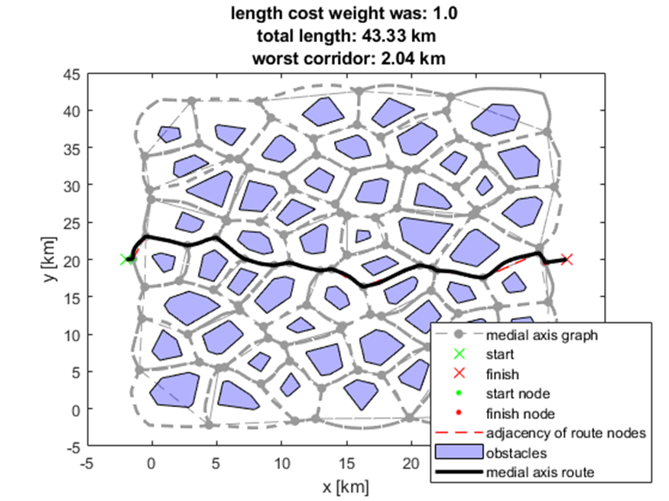
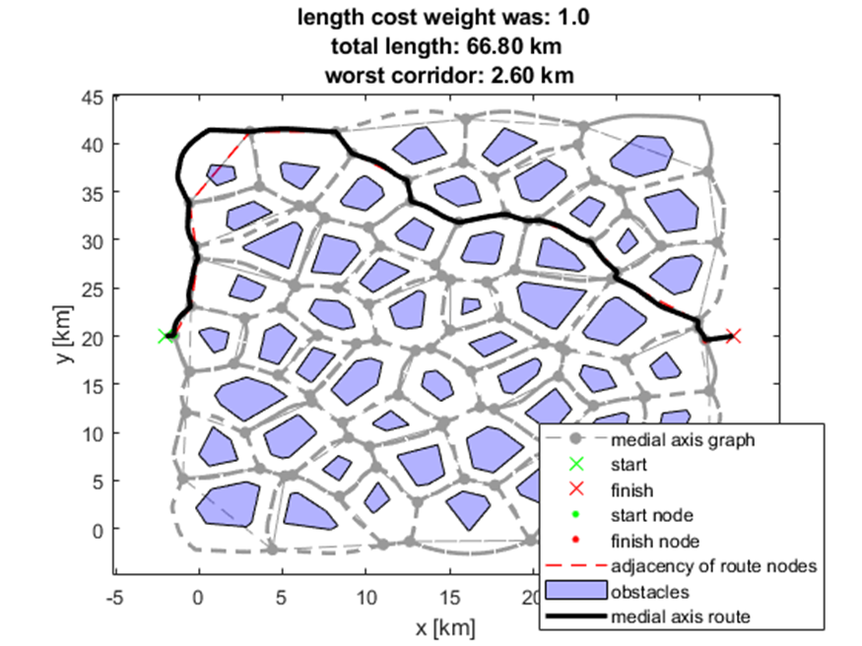
Planner behavior can be modified by changing what the cost function penalizes

Slide 14
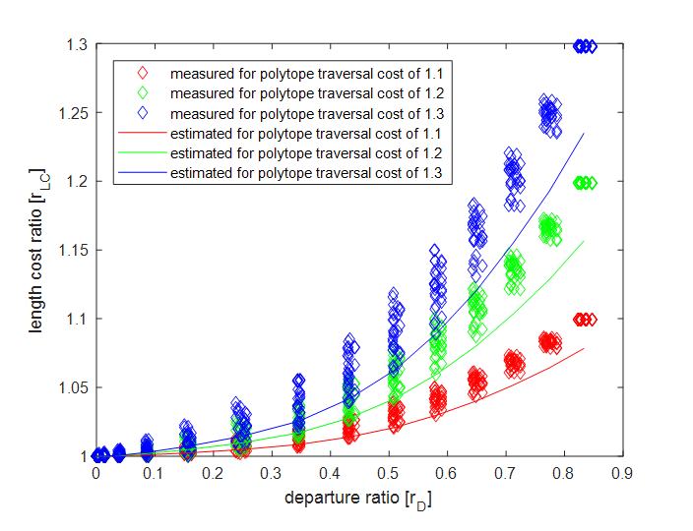
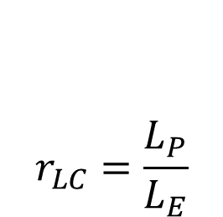
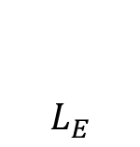
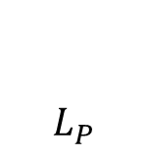
The length cost ratio estimates length navigation cost in a map without actually planning a path
$$r_{LC}=\frac{L_{P}}{L_{E}}$$
$$L_{P}$$
Estimated total path length
from start to goal
$$L_{E}$$
- distance from start to goal

Slide 15
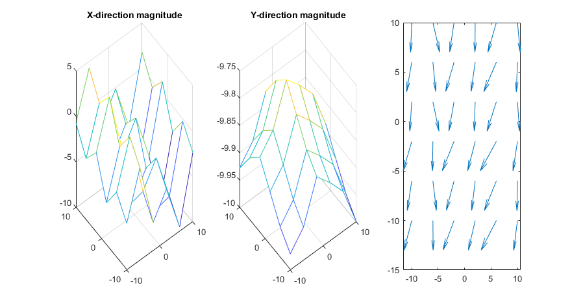
WIP: Wind field representation to be incorporated into cost

Slide 16


Questions?
sites.psu.edu/pangborn

Slide 17
Place highlights here.
Highlight details here.

